Slide 1
Control Structures: Branches, Conditional Branches and Procedure Calls
P&H Chapter 2.7, 2.8

Slide 2
Conditional Operations
Branch to a labeled instruction if a condition is true
Otherwise, continue sequentially
beq rs, rt, L1
if (rs == rt) branch to instruction labeled L1;
bne rs, rt, L1
if (rs != rt) branch to instruction labeled L1;
j L1
unconditional jump to instruction labeled L1

Slide 3
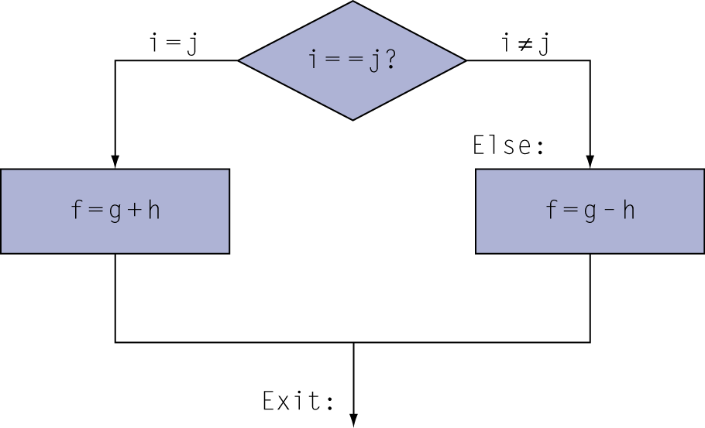
Compiling If Statements
C code:
if (i==j) f = g+h; else f = g-h;
f, g, … in $s0, $s1, …
Compiled MIPS code:
bne $s3, $s4, Else add $s0, $s1, $s2 j Exit Else: sub $s0, $s1, $s2 Exit: …
Assembler calculates addresses
Notes:
Can we use beq to do this?
Which branch is more expensive? The knowledge of which branch is more likely allows us to generate the more efficient code. E.g. exception handling.

Slide 4
Compiling Loop Statements
C code:
while (save[i] == k) i += 1;
i in $s3, k in $s5, address of save in $s6
Compiled MIPS code:
Loop: sll $t1, $s3, 2 # $t1 = i * 4(left shift 2) add $t1, $t1, $s6 # address of save[i] in $t1 lw $t0, 0($t1) bne $t0, $s5, Exit addi $s3, $s3, 1 j Loop Exit: …

Slide 5
Basic Blocks
A basic block is a sequence of instructions with
No embedded branches (except at end)
No branch targets (except at beginning)
A compiler identifies basic blocks for optimization
An advanced processor can accelerate execution of basic blocks
Notes:
Use this to introduce pipelining again and that branching destroys pipelining efficiency

Slide 6
More Conditional Operations
Set result to 1 if a condition is true
Otherwise, set to 0
slt rd, rs, rt
if (rs < rt) rd = 1; else rd = 0;
slti rt, rs, constant
if (rs < constant) rt = 1; else rt = 0;
Use in combination with beq, bne
slt $t0, $s1, $s2 # if ($s1 < $s2) bne $t0, $zero, L # branch to L

Slide 7
Branch Instruction Design
Why not blt, bge, etc?
Hardware for <, ≥, … slower than =, ≠
Combining with branch involves more work per instruction, requiring a slower clock
All instructions penalized!
beq and bne are the common case
This is a good design compromise

Slide 8
Signed vs. Unsigned
Signed comparison: slt, slti
Unsigned comparison: sltu, sltui
Example
$s0 = 1111 1111 1111 1111 1111 1111 1111 1111
$s1 = 0000 0000 0000 0000 0000 0000 0000 0001
slt $t0, $s0, $s1 # signed
–1 < +1 ⇒ $t0 = 1
sltu $t0, $s0, $s1 # unsigned
+4,294,967,295 > +1 ⇒ $t0 = 0
Notes:
slt is set of less than.

Slide 9
Procedure Calling
Steps required
Place parameters in registers
Transfer control to procedure
Acquire storage for procedure
Perform procedure’s operations
Place result in register for caller
Return to place of call

Slide 10
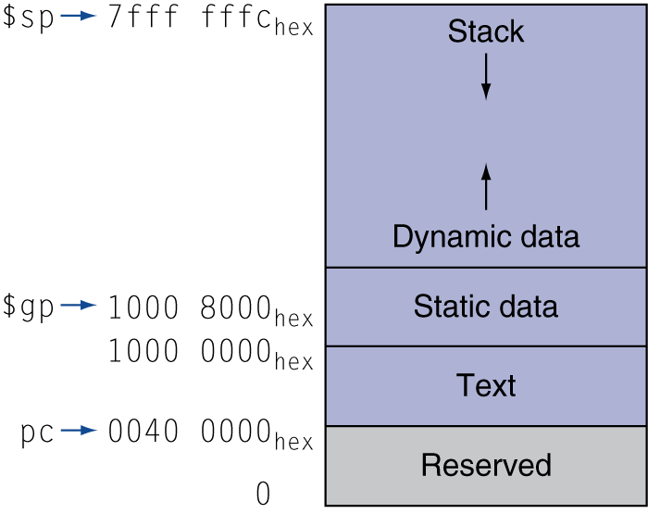
Memory Layout
Text: program code
Static data: global variables
e.g., static variables in C, constant arrays and strings
$gp initialized to address allowing ±offsets into this segment
Dynamic data: heap
E.g., malloc in C, new in Java
Stack: automatic storage

Slide 11
Register Usage
$a0 – $a3: arguments (reg’s 4 – 7)
$v0, $v1: result values (reg’s 2 and 3)
$t0 – $t9: temporaries
Can be overwritten by callee
$s0 – $s7: saved
Must be saved/restored by callee
$gp: global pointer for static data (reg 28)
$sp: stack pointer (reg 29)
$fp: frame pointer (reg 30)
$ra: return address (reg 31)
Notes:
Draw the address space of a program being executed.

Slide 12
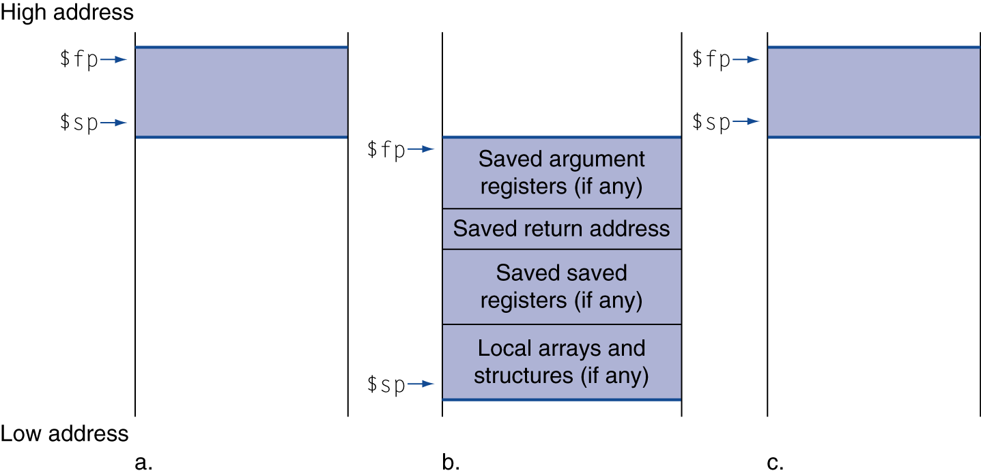
Local Data on the Stack
Local data allocated by callee
e.g., C automatic variables
Procedure frame (activation record)
Used by some compilers to manage stack storage

Slide 13
Procedure Call Instructions
Procedure call: jump and link
jal ProcedureLabel
Address of following instruction put in $ra
Jumps to target address
Procedure return: jump register
jr $ra
Copies $ra to program counter
Can also be used for computed jumps
e.g., for case/switch statements

Slide 14
Leaf Procedure Example
C code:
int leaf_example (int g, h, i, j) { int f; f = (g + h) - (i + j); return f; }
Arguments g, …, j in $a0, …, $a3
f in $s0 (hence, need to save $s0 on stack)
Result in $v0

Slide 15
Leaf Procedure Example
MIPS code:
leaf_example: addi $sp, $sp, -4 sw $s0, 0($sp) add $t0, $a0, $a1 add $t1, $a2, $a3 sub $s0, $t0, $t1 add $v0, $s0, $zero lw $s0, 0($sp) addi $sp, $sp, 4 jr $ra
Save $s0 on stack
Procedure body
Result
Restore $s0
Return

Slide 16
Non-Leaf Procedures
Procedures that call other procedures
For nested call, caller needs to save on the stack:
Its return address
Any arguments and temporaries needed after the call
Restore from the stack after the call

Slide 17
Non-Leaf Procedure Example
C code:
int fact (int n) { if (n < 1) return (1); else return n * fact(n - 1); }
Argument n in $a0
Result in $v0

Slide 18
Non-Leaf Procedure Example
MIPS code:
fact: addi $sp, $sp, -8 # adjust stack for 2 items (argument n and return address) sw $ra, 4($sp) # save return address sw $a0, 0($sp) # save argument slti $t0, $a0, 1 # test for n < 1 beq $t0, $zero, L1 addi $v0, $zero, 1 # if so, result is 1 addi $sp, $sp, 8 # pop 2 items from stack jr $ra # and return L1: addi $a0, $a0, -1 # else decrement n jal fact # recursive call lw $a0, 0($sp) # restore original n lw $ra, 4($sp) # and return address addi $sp, $sp, 8 # pop 2 items from stack mul $v0, $a0, $v0 # multiply to get result jr $ra # and return

